Slide 1
Workshop Trees

Slide 2
The idea behind a decision tree
Will it Rain Today
Rained Yesterday - Yes
Windy - Yes
Windy-No
Rained Yesterday - No
How could different variables influence outcome one at a time
Applications:
Given variables to make decisions
To also understand how certain groups differ from one another

Slide 3
Components
Rained Yesterday - No
Windy-No
Chance 40%
Windy – Yes Chance 80%
Rained Yesterday - Yes
Will it Rain Today
Root Node
Splitting Criteria
IntermediaryNode
Leaf Node
Leaf Node

Slide 4
An excel example
gender | Location | bought_last_30_days | buy
M | Metro | Y | buy
M | Non-Metro | N | no_buy
F | Non-Metro | N | no_buy
F | Metro | N | buy
M | Metro | Y | no_buy
M | Metro | N | no_buy
Quick concept
We need to split the dataset one variable at a time
Keep doing this recursively
Identify a stopping condition
Dep.
Variable
Independent Variables

Slide 5
Splitting Criteria – Gini Index
Buy/No
Buy 2
No Buy 4
Gender = F
Buy 1
No Buy 1
Gender = M
Buy 1
No Buy 3
0.42
Gini Impurity = 1 - ∑p(x_{i})^2
0.5
0.375

Slide 6
From Excel – Example (Gini)
splitting by metro
COUNTA of buy | buy
Location | buy | no_buy | Grand Total | gini at node | weights | weighted gini
Metro | 2 | 2 | 4 | 0.5 | 0.6666666667 | 0.3333333333
Non-Metro |  | 2 | 2 | 0 | 0.3333333333 | 0
Grand Total | 2 | 4 | 6 |  |  | 0.3333333333

Slide 7
Splitting Criteria – Information Gain
Buy/No
Buy 2
No Buy 4
Gender = F
Buy 1
No Buy 1
Gender = M
Buy 1
No Buy 3
0.87
Entropy = ∑-plog(p)
Information Gain = 1- Entropy
1
0.81

Slide 8
From Excel – Example (Entropy)
COUNTA of buy | buy
Location | buy | no_buy | Grand Total | prob1 | prob2 | Entropy | Weights | Weighted Entropy
Metro | 2 | 2 | 4 | 0.5 | 0.5 | 1 | 0.6666666667 | 0.6666666667
Non-Metro |  | 2 | 2 | 0 | 1 | 0 | 0.3333333333 | 0
Grand Total | 2 | 4 | 6 |  |  | 1 |  | 0.6666666667
Variable | Entropy | Info gain
gender | 0.874 | 0.126
location | 0.667 | 0.333
bought_last_30_days | 0.874 | 0.126

Slide 9
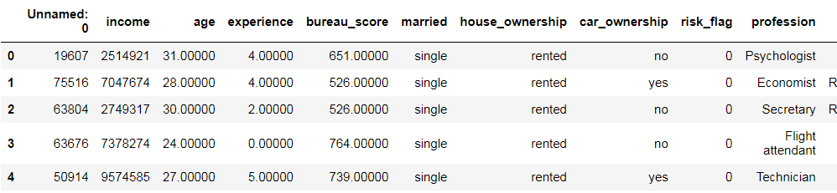

Problem - Dataset
Independent Variables:
Index(['income', 'age', 'experience', 'bureau_score', 'married', 'house_ownership', 'car_ownership', 'profession', 'city', 'state', 'current_job_years', 'current_house_years', 'device'], dtype='object')
Dependent Variable

Slide 10
A quick brush in Python notebook
Notes:
https://www.sebastian-mantey.com/code-blog/coding-a-decision-tree-from-scratch-python-p6-main-algorithm-2

Slide 11
Case Study 1
Credit card company wants to pre-approve its customers. It has many relevant details about the customers, we need to decide whether they should approve or not
Rows: Customers
Columns: CIBIL score, user location, age, income, gender, income, device etc
Labels: ‘Good’, ‘Bad’
Notes:
Come up with more features

Slide 12
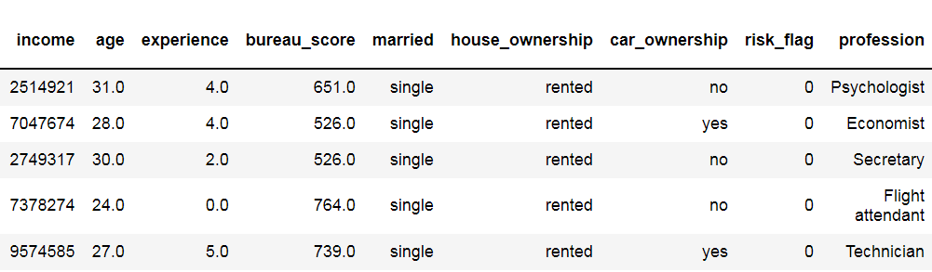
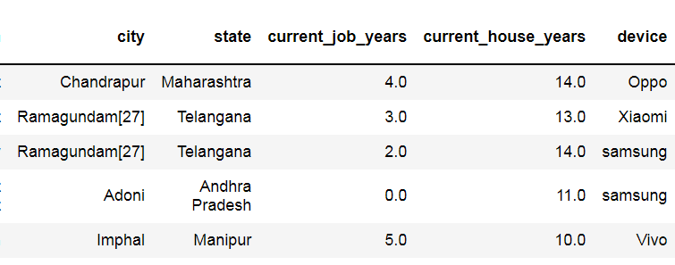


Lets look at the data
Label

Slide 13
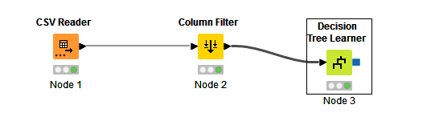
Basic Decision Tree (With KNIME)
Filter Columns
Filter Columns
Configure Dependent Variable

Slide 14
Decision Tree with Sklearn
Algorithm | Test | Training
Decision Tree | 0.527 | 0.527

Slide 15
Regression Trees
Take a feature and split
Get Variance of left node
Get Variance of right node
Weighted average of variance across all nodes
Pruning:
Cost Complexity alpha :
Tree score = (Sum of Error)^2 + alpha * number of terminal nodes
Different sub trees– Find the best alpha based on cross validation results
Variance = (X-mu)^2/N
Over to Excel File

Slide 16
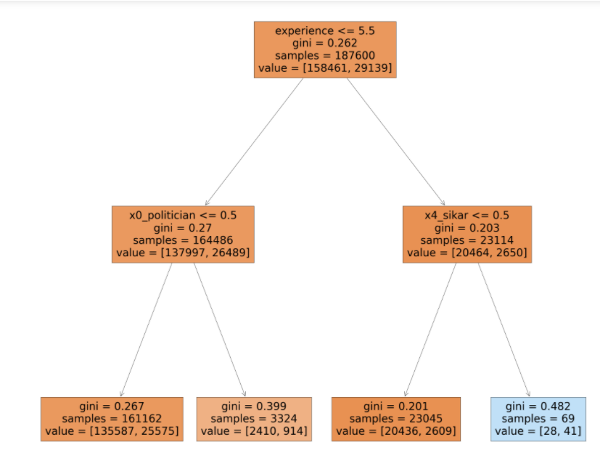
Hyper Parameters for decision trees
Alpha : cost complexity pruning
Splitting Criterion
Max features
Depth
Min samples split
Min samples Leaf
Max leaf nodes

Slide 17
Ensembles
Trees have low bias and high variance
Depth | Test | Training
5 | 0.527 | 0.527
50 | 0.818 | 0.877
100 | 0.882 | 0.995
Over Fitting
Solution: Build many ‘simple trees’ and take the final vote of the those predictions
Notes:
https://towardsdatascience.com/decision-trees-understanding-the-basis-of-ensemble-methods-e075d5bfa704

Slide 18

Little drops of water Little grains of sand, Make the mighty ocean, And the pleasant land – Julia Carney

Slide 19
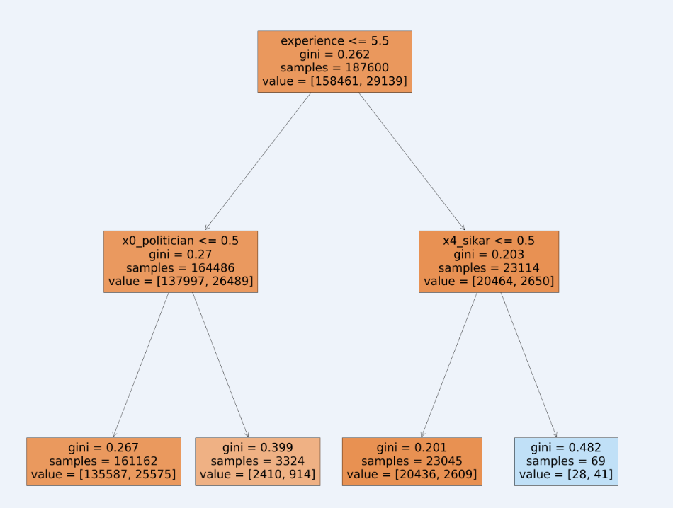
Bagging
Majority Voting
Final
Prediction
….
https://www.kaggle.com/prashant111/bagging-vs-boosting

Slide 20
Boosting
Error
Error
…..
W1
W2
W3
Weighted Decisions
Reduce Variance = Bagging
Reduce Bias = Boosting

Slide 21
Bagging and Random Forests
Random Forest is a special case of Bagging Algorithm
Bagging is more generic, can take any estimator
Bagging has subset of features in each training
RF takes a subset of features in each split
Algorithm | Test | Training | CV
Bagging | 0.942 | 0.982 | 0.938
RF | 0.96 | 0.982 | 0.956

Slide 22
Random Forest Sklearn (Key Parameters)
Handles higher dimensionality better
BootStrap (Sample or No Sample)
max_samples
N_estimators
Splitting Criterion
Max features
Min samples split
Min samples Leaf
Max leaf nodes

Slide 23
Tuning Random Forest
params = {
'n_estimators': [40,50,100],
'criterion': ["gini", "entropy"],
'max_samples': [0.1,0.2,0.5,1],
'max_features':[0.1,0.2,0.3]
}

Slide 24
Adaboost
New Sample weights
New Sample weights
New Sample weights
F1
Yes
No
F2
Yes
No
F1
Yes
No
F3
Yes
No
W1
W2
W3
W4
Ensemble for Decision
Excel for a detailed Demo

Slide 25
Adaboost Sklearn
Algorithm | Test | Training | CV
Bagging | 0.942 | 0.982 | 0.938
RF | 0.96 | 0.982 | 0.956
Adaboost | 0.623 | 0.628

Slide 26
Adaboost Sklearn Parameters
Buy/No
Buy 2
No Buy 4
Gender = F
Buy 1
No Buy 1
Gender = M
Buy 1
No Buy 3
Estimator – Default: Decision Tree with depth=1
N_estimators
learning_rate
Algorithm : SAMME (Discrete) & SAMME.R (Continuous)
Weight = Learning Rate *1/2 *(ln(1- Total Error)/Total Error)

Slide 27
Exercise Run Grid search
AB_grid= AdaBoostClassifier(random_state=42)
params = {
'n_estimators': [100,500],
'learning_rate': [0.2,0.5,1],
'algorithm': ['SAMME','SAMME.R'],
'base_estimator' : [DecisionTreeClassifier(max_depth=1),DecisionTreeClassifier(max_depth=2),DecisionTreeClassifier(max_depth=5)]
}
grid_search = GridSearchCV(estimator=AB_grid,
param_grid=params,
cv=2, n_jobs=5, verbose=1, scoring = "roc_auc")
grid_search.fit(df_all_test2,y_test1)

Slide 28
Gradient Boosting
Constant
Error 1
Base Value
Get Errors
Using errors as dependent variable build a tree
Repeat step 2 &3
c
Error 2
c
Error 3
c
Error = Actual – Predicted

Slide 29
Gradient Boosting in Excel
Log(odds) = log(event/no event)
P = exp(log(odds)/(1+exp(log(odds))
Log odds in a leaf node = Sum(Residuals)/sum(P*(1-P))
Prediction = Constant + Learning rate * Log(odds) in tree1 + Learning rate *Log(odds) in tree2…

Slide 30
Gradiet Boosting Sklearn
Algorithm | Test | Training | CV
Bagging | 0.942 | 0.982 | 0.938
RF | 0.96 | 0.982 | 0.956
Adaboost | 0.623 | 0.628
GB with 300 & Depth 5 | 0.902 | 0.948

Slide 31
Gradient Boosting Parameters
BootStrap (Sample or No Sample)
Subsamples (Stochastic Gradiet Boosting)
N_estimators
Loss (Deviance, Exponential)
Init : class_prior or 0
Splitting Criterion
Max features
Min samples split
Min samples Leaf
Max leaf nodes

Slide 32
XGB
Extreme Gradient Boost-- Regularization : To avoid over fitting
-- Different type of pruning
-- Gain Score Calculation
-- Parallelizeable (Cache memory, out of core computation)
Thresholds for numeric data using quantile technique
Missing Values handling
XGB for regression
Set initial value to 0.5
Get Residual
Do similarity & Gain score to determine the “best split”. Best Split is where the Gain is high
Calculate leaf level scores and add to the residual
Value of leaf
∑residuals
---------------
Count + Lamda
∑(residuals)^2
-------------------
Count + Lamda
Gain = Similarity of parent node – Similarity of child node
Similarity Score
Cover

Slide 33
XGB
XGB for classification
Set initial value to 0.5
Get Residual
Do similarity & Gain score to determine the “best split”. Best Split is where the Gain is high
Calculate leaf level scores and add to the residual
∑residuals
--------------------------
∑ p(1-p)+ Lamda
Value of leaf
∑(residuals)^2
----------------------------
∑ p(1-p)+ Lamda
Similarity Score
Cover
Gain Score
Similarity of parent node – Similarity of child node
Prune when gain of the last split is lower than a threshold
Don’t split when cover is less than a threshold
Update Residuals = Residual odds of last iteration + value of leaf

Slide 34
XGB in Sklearn
Algorithm | Test | Training | CV
Bagging | 0.940 | 0.982 | 0.938
RF | 0.961 | 0.982 | 0.958
Adaboost | 0.623 | 0.628
GB with 300 & Depth 5 | 0.902 | 0.948
XGB Default | 0.664 | 0.673
XGB with parameters | 0.797 | 0.811
Notes:
Things to do
0. Work on getting the best split for XGB regression tree for numeric values (Done)
0.a check calculations is right (yes going ahead)
Is pruning specific to XGB or GB (No CCP alpha is used in GB and threshold based pruning used in XGB)
Hyper parameters - https://medium.com/@gabrieltseng/gradient-boosting-and-xgboost-c306c1bcfaf5
What is early stopping (Monitor error on test set. IF test set is not improving despite improvement in train set, then stop early)
Examples

Slide 35
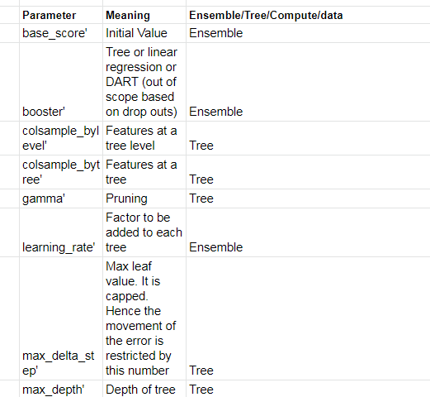
XGB Parameters

Slide 36
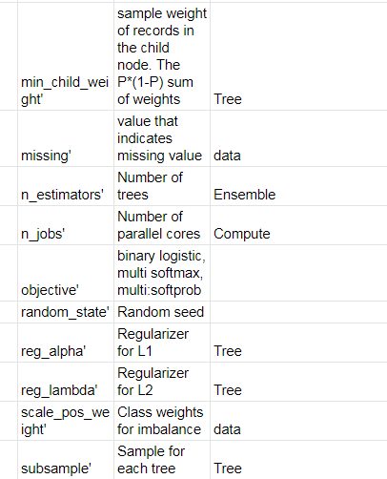
XGB Parameters

Slide 37
Comparing results
Notes:
Things to do
Get dt in final_codes (Added dataprep code. Remaining all data same)
Pickle in files
Change measuremet
The confusion on feature selection (We need to create thr 60% selection code in DT version1). The reupload in git ☹
Bagging code complete collab – note the final model perf metrics
Make sure all the slides contain the same number
Run dt_Version1 in collab
Move on to decision tree from scratch
Put the codes in github

